Slide 1
GCS ISO 9001 Certification
Gcs Training

Slide 2

Sag - Qms
Basic Training
Ewald Speicher
Eva Holmes
May 2018

Slide 3
Inhaltsverzeichnis
Sag Quality Management System Basic Training
1.
Introduction
4
2.
What is Quality?
12
3.
What is Quality Management?
18
4.
What is SAG‘s Quality Management System (QMS), how is it documented and where can I find it?
20
5.
What are the roles of the QMS?
36
6.
What are Quality Policy and Quality Objectives?
45
7.
What is ISO 9001 and the certification process
52
8.
How are internal and external audits conducted?
68

Slide 4
Inhaltsverzeichnis
1.
Introduction
4
2.
What is Quality?
12
3.
What is Quality Management?
18
4.
What is SAG‘s Quality Management System (QMS), how is it documented and where can I find it?
20
5.
What are the roles of the QMS?
36
6.
What are Quality Policy and Quality Objectives?
45
7.
What is ISO 9001 and the certification process
52
8.
How are internal and external audits conducted?
68

Slide 5
Quality Management Trainings
Structure
General
basic training for everybody
It is available as eLearning in iLearn as International Quality Management System
Specific
training for a specific function, e.g. Global Consulting Services, Global Support, Product Development
The specific part will be offered by your own quality management team
It is available as eLearning in iLearn as Product Development Quality Management System

Slide 6
Topic for The ISO 9001 Training
Content
ISO 9001 Standard - Generic
Basic Knowledge about the content and requirement of ISO 9001
What is Quality?
What is Quality Management?
What is SAG‘s Quality Management System (QMS), how is it documented and where can I find it?
What are the roles of the QMS?
What are Quality Policy and Quality Objectives?
What is ISO 9001 and the certification process?
How are internal and external audits conducted?
ISO 9001 Standard – GCS specific
GCS QMS and my role and contribution in my day to day business?
How is GCS include in the SAG QMS
GCS Quality Policy
GCS Quality Objectives global and for my Region
GCS QMS Roles
My contribution to deliver quality and generate customer satisfaction in my role as
Consultant or Architect
Project Manager
Line Manager
GCS Account Executive
Supporting Functions
Internal and external Audits
Notes:
The is an additional GCS specific information:
Everybody in GCS needs to be trained to understand what a quality management system (QMS) is and why SAG has implement it. We split the training in 2 parts.
The first one explains you the basics of the QMS of SAG. You will get basic information of the ISO 9001 standard , which describes, how a good QMS should look like and how we in SAG set up the QMS. You learn where to find and how to read the process documentation of our QMS. The training will inform you of the mandatory roles ISO 9001 expects and the fundamentals our Quality Policy and Quality objectives. As you know we not only implemented the QMS we want to get it externally certified to give our customers the confidence that we are able to satisfy their requirements. At the end we explain the certification process and your potential involvement in it.
In the second part we focus on the GCS part of the QMS. Here you will learn how GCS is included in SAG QMS. We present you our Quality Policy again with the Quality Objectives we gave us for 2018 how those are linked to our Quality policy and the break down the of Quality Objectives to the region. We give you an overview of the GCS part of the QMS with its processes documented in Aris. Afterwards we explain how you contribute to quality and customer satisfaction in your day to day business and where in the QMS Processes your contribution is documented. This part of the training is divided in several packages, one package for the major GCS roles: “Consultant or Architect”, Project Manager, Line Manager, GCS Account Executive, Supporting Functions.
The training ends preparing you for internal and external audits you might need to participate to maintain the certification showing the evidence that the QM is implemented and used and to identify things to improve.

Slide 7

Quality Management System
Why do we need a
ISO 9001
certification?
motivation
Why is the QMS important for the customer?
Why is the QMS important for Software AG?
Why is all this QM stuff important for me?

Slide 8
Quality Management System
Customer Compliance Requirements
Our Customers want to ensure that our products and services have adequate proven quality and pose no risk for their operations and survival.
Customer Compliance Expectations
Ensure Quality
Ensure Business Continuity
Ensure Information Sec.
ISO 9001 Certification of Global Support
Product Development &GCS
ISO 22301 Certification
of Global Support
Renewal and enhancement of Global Security Policies
Company-wide rollout of
the security policies

Slide 9
Quality Management System
Motivation
Why is the QMS important for Software AG?
Loss of Deals (New customers do not take us into final consideration)
New customers want a confirmation that we get certified in the contract.
Existing customers ask for it as well.
It will help us to improve our quality culture.

Slide 10
Quality Management System
motivation
Why is all this QM stuff important for you?
It is easier and quicker to find relevant information for your daily work
You have influence on improvements of your daily work
You might be in an audit and the auditor will ask you

Slide 11
Quality Management System
What you should know after this training
What is ISO 9001 and the certification process?
What is Quality?
How are internal and external audits conducted?
Training
What is Quality Management?
What are Quality Policy and Quality Objectives?
What is SAG‘s Quality Management System?

Slide 12
Inhaltsverzeichnis
1.
Introduction
4
2.
What is Quality?
12
3.
What is Quality Management?
18
4.
What is SAG‘s Quality Management System (QMS), how is it documented and where can I find it?
20
5.
What are the roles of the QMS?
36
6.
What are Quality Policy and Quality Objectives?
45
7.
What is ISO 9001 and the certification process
52
8.
How are internal and external audits conducted?
68

Slide 13

Quality

Slide 14

Discussion
What do you mean when you talk about „Quality“?

Slide 15
The Concept of Quality
5 Views (GARVIN )
Quality
Transcendent
Product related
Customer related
Value related
The „common sense“ concept of quality
A product meets general requirements
e.g. the faster a car the better its quality
Quality is absolute; you can perceive it immediately
Quality is fulfillment of requirements the customer has
Core of ISO 9001
Quality means cost-benefit ratio is best
Process related

Slide 16
The Concept of Quality
ISO 9001:2015
Quality: „degree to which a set of inherent characteristics of an object fulfils requirements”
Requirements: “…expectation that is stated, generally implied or obligatory”
Requirements can be generated by different interested parties (customers, owners, people in an organization, suppliers, ….)
The essence of quality is fulfilling requirements (not only from customers). But how can we be sure to know them all and to make sure that we meet them?

Slide 17
The Concept of Quality
Doing It Right The First Time
Principle: The system of quality is prevention
But prevention means cost – does quality management make the product more expensive?
No: The measurement of quality is the reduction of the price of nonconformance
…. good quality management principles will see savings returns that more than pay for the cost of the quality system: "quality is free".
Because it is less expensive to do it right the first time than to pay for rework and repairs.
Philip Crosby

Slide 18
Inhaltsverzeichnis
1.
Introduction
4
2.
What is Quality?
12
3.
What is Quality Management?
18
4.
What is SAG‘s Quality Management System (QMS), how is it documented and where can I find it?
20
5.
What are the roles of the QMS?
36
6.
What are Quality Policy and Quality Objectives?
45
7.
What is ISO 9001 and the certification process
52
8.
How are internal and external audits conducted?
68

Slide 19
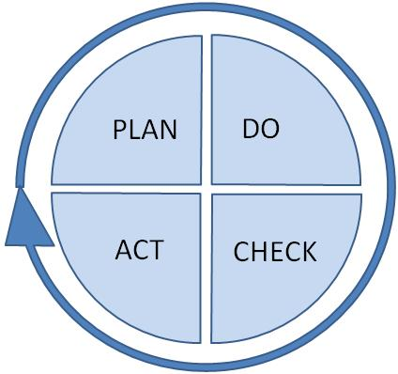
Quality Management Activities
and PDCA circle
Quality Planning
Quality Control
Quality
Improvement
Quality
Assurance
Notes:
Quality planning: ...focuses on setting quality objectives and specifying necessary operational processes and related resources to fulfill the quality objectives
Establishing quality plans can be part of quality planning
Quality control: ...focuses on fulfilling quality requirements
Quality assurance: ..focuses on providing confidence that quality requirements will be fulfilled
Quality improvement: ..focuses on increasing the ability to fulfill quality requirements

Slide 20
Inhaltsverzeichnis
1.
Introduction
4
2.
What is Quality?
12
3.
What is Quality Management?
18
4.
What is SAG‘s Quality Management System (QMS), how is it documented and where can I find it?
20
5.
What are the roles of the QMS?
36
6.
What are Quality Policy and Quality Objectives?
45
7.
What is ISO 9001 and the certification process
52
8.
How are internal and external audits conducted?
68

Slide 21

Quality Management System (QMS)
Purpose & Structure

Slide 22


Quality management System (QMS)
Quality
Quality Management
Quality Management System (QMS)

Slide 23
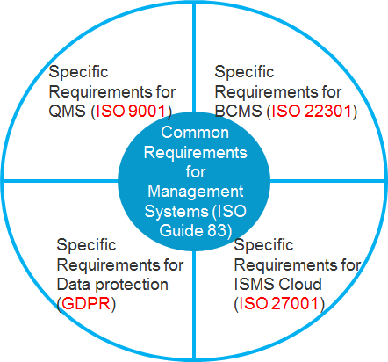
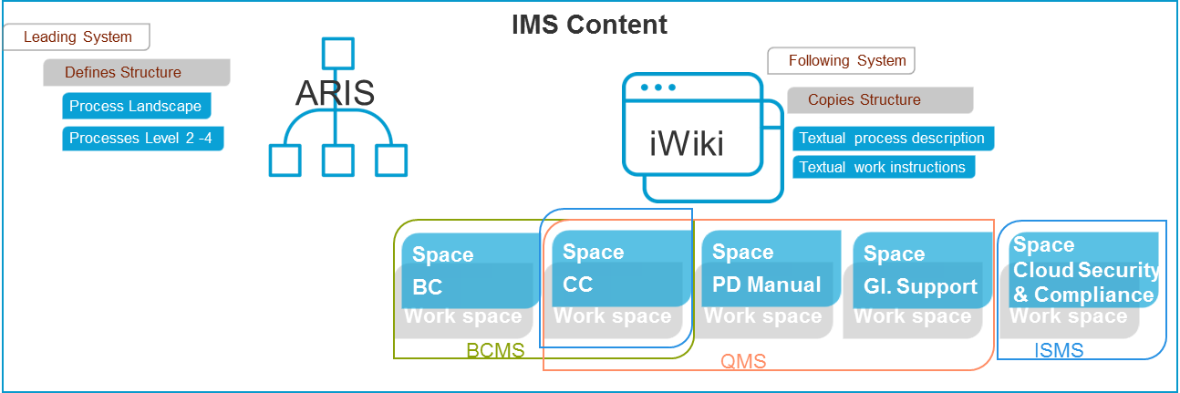
QMS as part
of the Integrated management system
Common requirements of the ISO standards
Common elements of the implementation

Slide 24
What is a Quality management System (QMS)?
Quality Management System
…management system to direct and control an organization with regard to quality
Management System
… system to establish policies and objectives and to achieve those objectives
Quality
… degree to which a set of inherent characteristics fulfills requirements
Source: EN ISO 9000:2005

Slide 25


Basic Components of a QMS
(ISO 9001:2015)
A QMS supports the organization in managing quality.
QMS components
Quality policy & quality objectives
Processes & deliverables
Roles & responsibilities
…

Slide 26


Software AG’s QMS
integral parts
Guiding
document
How to use Software AG‘s QMS
Quality policy
Software AG‘s quality policy
QMS in ARIS:
Processes - Roles - IT systems, Input & output, …
Software AG‘s processes
- the core of SAG‘s QMS -
Links from ARIS to iWiki spaces
(e.g. Additional textual process descriptions, work instructions, templates, check lists)
Process details

Slide 27
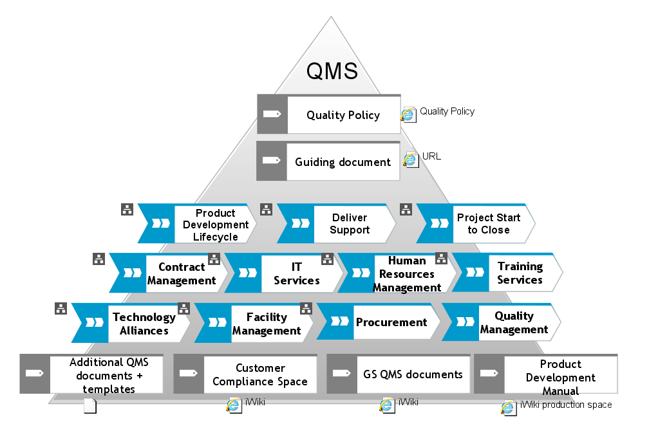
QMS
essential Parts
Quality Policy
Guiding Document
ARIS Processes
PRIME
iWiki
IMS Documents
GS Documents
PD Manual
PD Organizational knowledge

Slide 28


QMS in ARIS
Process Architecture & Process Levels
Our processes are designed top-down – on different levels of detail.
The number of levels
… is not predefined (fixed).
… depends on the complexity of the processes.
The graphical representation of a process is determined by the process level.

Slide 29


QMS in ARIS
Process Architecture & Process Levels
Value-added chain diagrams (VACD) are used on a higher process level.
Event-driven process chains (EPC) are used on a more detailed process level.
The processes are created by ARIS modelers.
Most of you only need to know how to ‚read‘ the process models.

Slide 30
VACD = Value-Added Chain diagram
A VACD can be used to describe …
the hierarchical structure of processes
-> superior/subordinate processes
the sequence of processes
-> predecessor/Subsequent processes
Examples: iWiki https://iwiki.eur.ad.sag/display/CCDEV/Alternatives+for+VACDs

Slide 31
EPC: Event-Driven process chain
An EPC is used to describe …
the control flow, i.e. the chronological and logical sequence of functions (activities, process steps, …) in a process
the roles involved in process steps
-> R-A-C-I
the IT-system used in process steps
the input/output (data, documents, checklists, …) of process steps
…
Example: EPC iWiki page Modeling EPCs

Slide 32
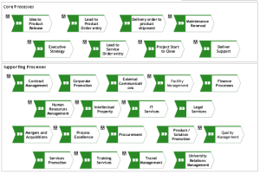
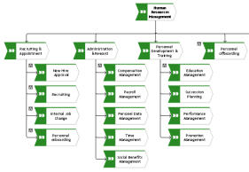
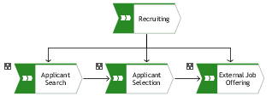
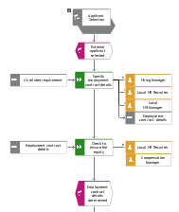
Process Architecture & Process Levels In ARIS
example
Process Landscape
VACD
Level 1
VACD
Key Processes
Level 2
VACD
Main Processes
(optional)
Level 3
EPC
EPC
Processes
Level 4
Detailed Processes
(optional)
Level 5

Slide 33
Access to SOFTWARE AG‘s QMS
Our QMS is accessible via
… the ‘QMS System’ quick link on the intranet
http://intranet.eur.ad.sag/dach/default.asp
… SAG’s process landscape in ARIS
https://processexcellence.eur.ad.sag/#default/item/c.chain.P_MGMSYS.LeKYwHedEd8n7QBQVqcDXw.-1

Slide 34

Software AG’s
Process Landscape
This symbol shows you that you can drill-down to more detailed processes.
-> Click it to navigate to the next level.

Slide 35
Discussion
Why do we need a QMS?
Is not the intranet the place to find all information we need for our daily work?

Slide 36
Inhaltsverzeichnis
1.
Introduction
4
2.
What is Quality?
12
3.
What is Quality Management?
18
4.
What is SAG‘s Quality Management System (QMS), how is it documented and where can I find it?
20
5.
What are the roles of the QMS?
36
6.
What are Quality Policy and Quality Objectives?
45
7.
What is ISO 9001 and the certification process
52
8.
How are internal and external audits conducted?
68

Slide 37
QM Related Roles

Slide 38
QM Related Roles
Quality Management Responsible (QMR)
In charge of all activities related to the Quality Management System.
Manage the internal and external audit programs for all required audits
1
4
Warranty of ISO 9001-conformity and other compliance demands in respect of the QMS
Publishing and announcements of new versions of the QMS
2
5
Respective continuous training programs & also quality motivation
3
Notes:
The QMR is nominated by the board and has the overall responsibility for the Quality Management System. For software AG Ewald Speicher is the quality management responsible.
He is in charge of all activities that are related to the QMS.
This means, the QMR has to make sure that the QMS is compliant to the ISO 9001 standard and to all other demands, such as legal or administrational requirements or company policies.
The internal and external audit programs is set up by the QMR. All required audits are scheduled and auditors assigned. After the final report is sent he creates the resulting actions for non-conformities and improvements and assigns them to Quality Manager of the audited department.
Another important task is the implementation of a training program for the QM relevant topics. All employees of the certified departments have to participate in these trainings.
The QMR is responsible for the versioning of the QMS. He publishes and announces the new versions.
The QMR participates in the Management reviews and drives the continuous improvement process.

Slide 39
QM Related Roles
Quality Sponsor
Responsible for the Quality strategy and Quality Management of a process area (for example R&D, Global Support, internal IT (GIS), HR....)
Participate at the Quality Management review
1
3
Decides about quality goals and quality related KPIs for the scope of his responsibility
For Global Support: Paul Smith
For PD: Michael Schumacher
For GCS: Arno Theiss
2
4
Notes:
The Quality Sponsor is responsible for the quality strategy and Quality Management of a process area. In software AG Padma Reddy is the quality sponsor for Product Development.
And Paul Smith is quality Sponsor for Global Support. The supporting functions do not have quality sponsors so far.
The QS decides about quality goals and quality related KPIs for the scope of his or her responsibility.
He or she participates in the Quality Management review to present and drive all quality management related issues and improvements.

Slide 40
QM Related Roles
QM-Manager
Takes care of the Quality strategy and Quality Management of a process area (for example R&D, Global Support, GIS ,HR....)
Responsible to track corrective actions and quality improvements in his process area
1
4
Reports the QM-Status and KPIs to the head of the process area
First contact person for internal and external audits concerning his process area
2
5
Responsible for adequate quality management related (delta) trainings for his process area
Global Support: Jill Henley PD: Frank Strauch
GCS: Markus Kuepper CU: Peter Dern
GIS: Kerstin Thuermer HR: Carmen Ziegler TA: Claudia Reutzel FM: Peter Cebulla QE: Eva Holmes
3
6
Notes:
Each department within the focus of the certification has a Quality Manager. They are:
Jill Henley for Global Support
Frank Strauch for Product Development
Markus Kuepper for GCS
Kerstin Thuermer for IT Services
Carmen Ziegler for Human Resources
Clemens Klein for Facility Management
Claudia Reutzel for Technology Alliances.
Peter Dern for Corporate University
The Quality Managers take care of the Quality strategy and Quality Management of the correspondent department.
They are responsible that the processes and tools that are needed for compliance are designed and implemented for their process area.
They reports the QM-Status and KPIs to the head of their department.
They make sure adequate quality management related trainings for the process area take place.
For the QMR they are the contact person for internal and external audits. They recommend the auditees and inform them about the audits. They are the coach and contact person for the auditee for all questions concerning the audit preparation. They do department related training and other audit preparation with the auditees.
For product development there is a special training.
Corrective actions and quality improvements from the audits are assigned to the Quality Managers of the audited department. They are also responsible to drive the implementation and report the status.

Slide 41
QM Related Roles
Quality Responsible
Reports in this function to the QM-Manager of his process area
Responsible for quality records linked to his scope of responsibility
1
4
Responsible for Quality Assurance activities
For PD: Thomas Stelzer, Jörg Streibert, Ursula Noll, Albert Zenkoff, Rameshchandra Veeturi, Satish Shankar, Mariya Mladenova, Stefka Dimitrova
For GCS: DACH/EE: Jens Tregel, Pia Pfeifer; APJ/ME: Vijay Chikkanna, Joao Antunes; WE&SA: Jackie Hall, David Hughes;
Israel: Rachel Yosef; Americas: Carol Patecell, Alessandra Teixeira, Efrain Ascanio; Iberia: Ana Belen de Lucio Obregon
2
5
Defines work instructions, checklists etc.
3

Slide 42
QM Related Roles
PD QMS Coordination Team (QCT)
Reports in this function to the QM-Manager of Product Development
Performs the initial inspection of the reported impediments.
1
4
Responsible for Quality Assurance of the PD part of the QMS
For PD: Michael Backhaus, Ina Ivanova,
2
5
Responsible for PD QMS maintenance
3
Notes:
This team acts as quality responsible for the PD part of the QMS.

Slide 43
QM Related Roles
Internal Auditor
Invites the auditees to the internal audit
Conducts the closing meeting.
1
4
Prepares and conducts internal audits.
Pre-Audit Meeting
Audit
2
Internal Auditors:
5
Aparajitha Kavanoori, Ewald Speicher, Eva Holmes, Jill Henley, Regina Huegle, Markus Kuepper, Gerard McCann, Rainer Mueck, Johannes Richard Roemann, Andreas Sievert, Jens Tregel
Writes the audit report
3
Notes:
The auditors Lead and Co-Auditor are assigned to the audit by the QMR when the audit program is set up. The internal auditor has to be neutral. He/she should not be involved in Audit preparation of the auditees.

Slide 44
Extended QM Team
Team Structure
Steering Committee
QM Core Team
Global Support QM Team
R&D QM Team
HR QM
Team
GIS QM Team
Facility Mgmt QM Team
Quality Excellence Team
TA QM
Team
GCS QM Team
Jill Henley
Tasks:
Design and implementation of the processes and tools we need for compliance
Coordination of overall topics
Transmission belt for the departments involved
Ewald Speicher
Eva Holmes
Frank Strauch
Markus Kuepper
Peter Cebulla
Kerstin Thuermer
Claudia Reutzel
Carmen Ziegler
Notes:
The Quality Managers meet regularly in the core team meeting. It is organized by the Quality Management Responsible. This meeting serves the coordination for the overall project.
Here the QMs discuss QMS related topics such as
Organizational and Process related issues or problems
They present the status of their progress in implementing and rolling out the required processes.
Proposals for proceeding or changes
Internal and external audit related issues
The quality managers also take information gained in these meetings back to their departments.

Slide 45
Inhaltsverzeichnis
1.
Introduction
4
2.
What is Quality?
12
3.
What is Quality Management?
18
4.
What is SAG‘s Quality Management System (QMS), how is it documented and where can I find it?
20
5.
What are the roles of the QMS?
36
6.
What are Quality Policy and Quality Objectives?
45
7.
What is ISO 9001 and the certification process
52
8.
How are internal and external audits conducted?
68

Slide 46
Quality Policy & Quality Objectives
Notes:
The ISO standard 9001 requires that the general quality policy of the organization is defined by the CEO or the board. It has to be compliant with the strategic direction and the context of the organization. The head’s of the departments Global Support and Product Development have derived a quality policy for their organizations according to the company’s quality policy and the context of their departments.
Everyone working in the organization has to be aware of the quality policies. Top management is responsible for communication of the policy.
Software AG‘s quality policy was announced in the Inside Express#68 on the 2nd of October 2015 by Karl-Heinz Streibich. It is published in the intranet on the ‘QM System’ page.
The quality policy sets the direction of the quality management system.

Slide 47
Quality Policy of Software AG
Characteristics
A Quality Policy is necessary as basis to set the direction for the Quality Management System
It is defined by Top Management (CEO)
The quality objectives are derived from the Quality Policy
Notes:
Quality goals and objectives have to aligned with the quality policy.
The quality policy sets the direction of the quality management system.

Slide 48
QUALITY POLICY OF SOFTWARE AG
general
“Customer Success by creating customer value is at the heart of everything we do.”
We enable our customers to succeed and stand out in the digital world. To do so, we have developed the world’s first Digital Business Platform that enables businesses to create a new generation of adaptive real-time applications.
In order to enable this achievement for our customers, every employee of Software AG makes a commitment
to put the customer at the center of everything we do, from product innovation driven by customer collaboration and co-innovation, to the way we sell and service our solutions,
to ensure compliance with laws and regulations pertaining to quality, safety and performance requirements in every country where Software AG’s products and services are offered, and
to support and continuously improve Software AG’s Quality Management System.
These commitments will be met with transparency and integrity, through clearly documented processes, KPIs including quality objectives, routine quality management reviews, and a company culture that is dedicated to quality.
Notes:
Software AG‘s quality policy was announced in the Inside Express on the 2nd of October 2015 in the Inside Express #68 by Karl-Heinz Streibich.
He wrote:
The basis for the quality management system is Software AG’s quality policy. It establishes the framework for the quality goals that we wish to achieve under the certification. Our clients’ success is the yardstick for everything we do. It is therefore at the heart of our quality policy as well, which has now been approved by CEO Karl-Heinz Streibich and is binding for all employees.

Slide 49
Global Support
QUALITY POLICY
A
In the 24x7 digital world, our customers expect Global Support services to be available at all times to ensure continuity of their critical business systems. To meet these expectations, Software AG Global Support is committed to quality at every level of the organization. We achieve this by
–empowering our employees
–constantly improving our skills
–continuously measuring and monitoring customer satisfaction
–implementing innovation to improve both the customer experience and our own efficiency.
Our business continuity strategy ensures that our customers will receive the required support services at all times.

Slide 50
PRODUCT DEVELOPMENT
QUALITY POLICY
A
Software AG RnD’s investment in quality management is paired with a commitment to customer-centric development, which means that the customer is deeply involved in the cycles that lead from an idea to a product.
Clearly defined development and testing processes coupled with feedback loops ensure the agility and flexibility required to supply best-of-breed software, providing our customers with the competitive advantage they seek.
Frequent delivery and continuous improvement are a strong platform to achieve and increase operational efficiency and excellence.

Slide 51
GCS Quality Policy
ISO 9001 Certification
Improvement
Commitment
Measure & monitor satisfaction for continuous improvement
Improve
Commit
Committed towards quality and creating customer value
Quality
Success
Value
Risk Management
Focus
Review
Focus
Regular reviews to identify & eliminate risks
Consequent focus on customer‘s strategy, objectives & requirements
Deliver
Prime
Empower
Empowerment
Our methodology to ensure successful delivery
Empowering our employees and improving their skills
Notes:
In GCS we are focused on our customers and their strategies. We fulfil their requirements and help them to achieve their objectives. Doing this we create customer value.
We are committed to quality . Our ability to deliver quality services is based on the skills of our employees and their continuous development and empowerment. We defend quality with our professional risk management and our long lasting experience and organisational knowledge conserved in our delivery methodology Prime, which is the heart of our QMS.
We regularly evaluate, if our QMS fits for purpose and if we could satisfy our customers. We listen to customers suggestions and encourage our employees to share their concerns about problems and ideas to improve our process. We eliminate the problems we detect and implement proposed improvement to ensure contously improvement.

Slide 52
Inhaltsverzeichnis
1.
Introduction
4
2.
What is Quality?
12
3.
What is Quality Management?
18
4.
What is SAG‘s Quality Management System (QMS), how is it documented and where can I find it?
20
5.
What are the roles of the QMS?
36
6.
What are Quality Policy and Quality Objectives?
45
7.
What is ISO 9001 and the certification process
52
8.
How are internal and external audits conducted?
68

Slide 53

What is ISO 9001
Eduardo Martínez Da Silva, Marcos Montes Martín, Iván Melero Cañas, Raquel Entremonzaga Ayuso Photographed by Daniel Genovés Isidro
Spain, Tres Cantos

Slide 54

ISO Organization
http://www.iso.org
ISO = International Organization for Standardization
Independent, non-governmental membership organization
The world's largest developer of International Standards
163 member countries (national standards bodies)
Central Secretariat in Geneva (Switzerland)

Slide 55
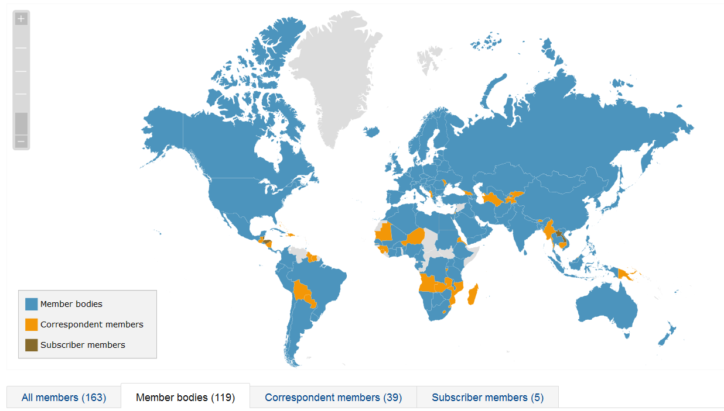
ISO Organization
Countries of the World that are Members
119 full members
39 correspondent members

Slide 56
What is ISO 9001 for?
ISO 9001 is part of the ISO 9000 Family:
International Standards that concern Quality Management
The ISO 9001 is “the world's leading Quality Management standard”
In fact ISO 9001:2008 is implemented by over 1.1 million companies and organizations in over 170 countries.
Revision 9001: 2015: SAG certification pioneer (Among the first 5 )

Slide 57
ISO 9001
ISO 9001 sets out the criteria for a Quality Management System and is basis for certification.
This standard is based on Quality Management principles
strong customer focus,
the motivation and implication of top management,
the process approach
continuous improvement
Using ISO 9001 helps ensure that customers get consistent, good quality products and services

Slide 58
Iso 9001:2015
Overview
Quality Management System (4.3/4.4)
Support Processes (7)
Organization and its context
(4.1)
Customer Satisfaction
Operations (8)
Do
Plan
Outputs
Customer
Leadership (5)
Requirements
Planning
(6)
Performance Evaluation (9)
Outputs
Product & Services
Check
Needs & Expectations
Act
Relevant interested parties
(4.2)
Improvement (10)

Slide 59

Certification

Slide 60
Certification
What’s that?
Certification is a third party’s independent assessment to make sure that the QMS meets the requirements of the ISO 9001
Our certification body is the DQS
Our external auditor is Mr. Vasen
There will be a „surveillance audit“ every year
Notes:
Our external auditor is Mr. Ingo Vasen. This is the 3rd year he audits software AG for ISO 9001.
He has a computer science back ground and works as an independent auditor for DQS.
To keep the certification going external audits have to be conducted every year. Every 3rd year a recertification takes place.
The amount of audits is defined by the DQS according to the number of employees, departments and locations in scope of the certification.

Slide 61
ISO 9001
Certification Scope
Scope for re-certification audit 2018
3.040
Employees
48
Locations
Notes:
In 2013 we have 3.040 employees in 48 locations world wide in scope of the certification.

Slide 62
Internal / External QM Audit Train
3-year cycle Regions / locations - Change
2015
2016
2017
2018
2019
2020
2021
HQ
NCSA
HQ
EU
HQ
APJ
HQ
EU
HQ
NCSA
HQ
APJ
HQ
EU
Recertification and
GCS initial
certification
GS Initial certification
PD Initial certification
Surveillance audit
Surveillance audit
Surveillance audit
Recerti- fication
Note: NCSA = North, Central and South America
Notes:
As not all locations can be audited in one year 3 year cycle has been set up with focus on one continent per year. This cycle started in 2015 with America, last year Asia was in focus, this year the cycle will start again with Europe.
HQ has to be audited every year.

Slide 63
Internal Audit Schedule 2018
Start | End | Location
14 May | 16 May | Berlin, Leipzig
11 June | 15 June | Sofia
18 June | 19 June | Vienna
20 June | 22 June | Saarbrücken (only BC)
25 June | 26 June | Paris
4 Sept | 5 Sep | Düsseldorf
May | Sep | Darmstadt
Sep | Oct | South Africa, UK, Munich (remote)

Slide 64
2018 MulTI-Norm audits SAG
Start | End | Duration | Location
29 Oct | 31 Oct | 3 days | HQ (Darmstadt) ISO 22301
19 Nov | 20 Nov | 2 days | Sofia ISO 9001
21 Nov | 21 Nov | 1 day | Vienna ISO 9001
22 Nov | 22 Nov | 1 day | Kosice ISO 9001 (remote)
23 Nov | 23 Nov | 1 day | Paris ISO 9001
26 Nov | 26 Nov | 1 day | Düsseldorf ISO 9001
27 Nov | 27 Nov | 1 day | Berlin ISO 9001
28 Nov | 28 Nov | 1 day | Leipzig ISO 9001
29 Nov | 30 Nov | 2 days | Darmstadt ISO 9001
12 Dec | 14 Dec | 3 days | Darmstadt ISO 27001

Slide 65
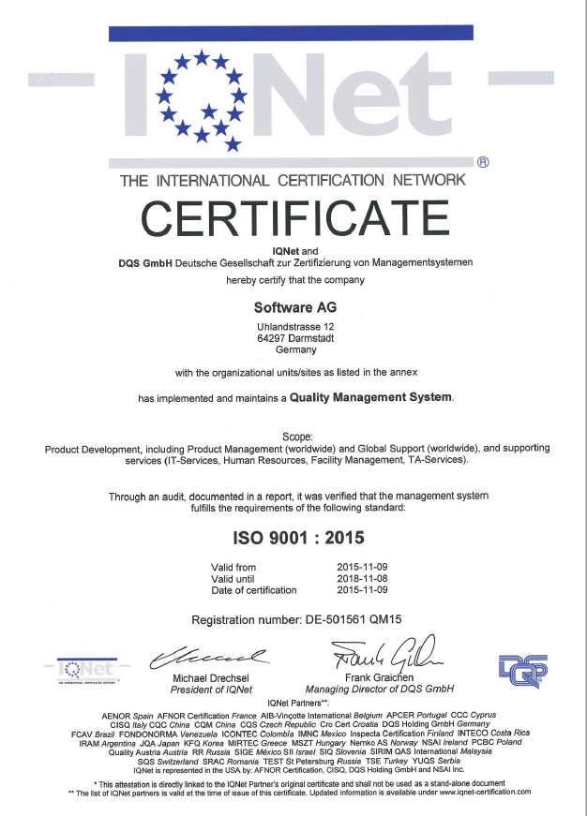
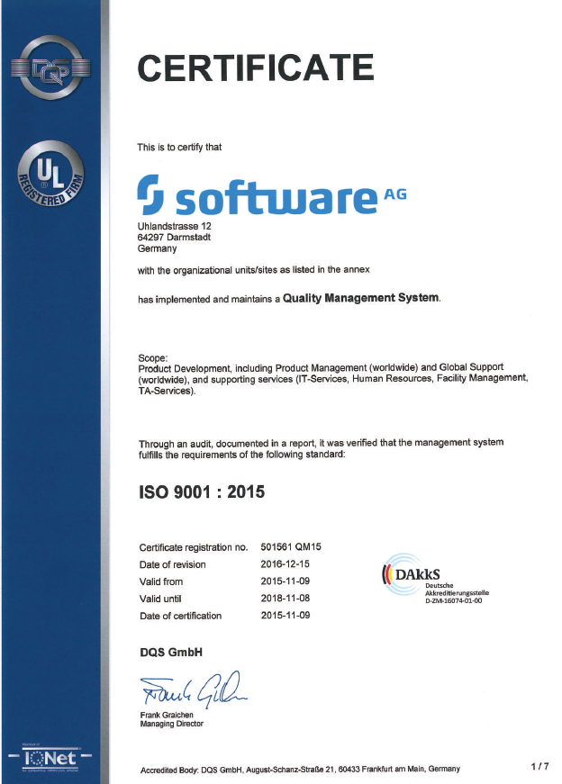
Certificates

Slide 66
Discussion
What is your benefit from the QMS ?

Slide 67
Internal Audits

Slide 68
Inhaltsverzeichnis
1.
Introduction
4
2.
What is Quality?
12
3.
What is Quality Management?
18
4.
What is SAG‘s Quality Management System (QMS), how is it documented and where can I find it?
20
5.
What are the roles of the QMS?
36
6.
What are Quality Policy and Quality Objectives?
45
7.
What is ISO 9001 and the certification process
52
8.
How are internal and external audits conducted?
68

Slide 69
Internal (Quality) Audits
Internal audits are a mandatory instrument of Quality Management
The objectives of internal audits are:
Evaluation of the degree the QMS is part of daily work
Find ways how we can improve what we do
The internal audit is also a training for the external audit
Notes:
Internal audits are a requirement of the ISO 9001 Standard.
We want to find out :
Do you know the QMS?
Do you know the processes that are relevant for your daily work?
Can you explain the processes?
Is your work organized in the way the process describes?
Does the process description help you to do your work?
Do you see any possibilities for improvement in the processes?
The internal audit is a training and preparation for the external audit.
You have trained the audit situation.
You know what to expect.

Slide 70
Phases of the Internal Audit
Auditee Perspective
Pre-phase
Internal and external audit program is planned by the QMR and approved by the Management Review Meeting
Conduction of the Audit
Introduction of the participants and outline of their roles and organisation
Short presentation of the auditee and the product (in case of PD) is useful
Post-phase
Closing Meeting: Audit findings will be presented by the audit team .Any diverging opinions regarding the audit findings or conclusions between the audit team and the auditee should be discussed.
Grant lead auditor access to the necessary documentation to plan the audit
Deliver information the auditors need by answering questions, grant access to documents and application systems, deliver evidence for the information
Post-audit activities are defined and tracked in the ISO Governance App (e.g. implementation of corrective actions, improvements)
Contact to the auditee will be established by the lead auditor and inform about the audit scope
QMR informs QM-Manager about the planned internal and external audit program and the time frame
Auditees are briefed and trained by the QM-Manager
Auditees participate at the general QM training and (if they are part oft PD) at the PD QM Training
Arrangements for the audit (scheduling date, participants..) are made

Slide 71
Internal Auditors
Software ag team
Lead Auditors:
Co Auditors:
Aparajitha Kavanoori,
Ewald Speicher,
Eva Holmes,
Jill Henley,
Regina Huegle,
Markus Kuepper,
Gerard McCann,
Rainer Mueck,
Johannes Richard Roemann,
Andreas Sievert,
Jens Tregel

Slide 72
How to behave in an Audit
It is not you who is audited, but the processes you are involved in.
Be honest, cooperative and comprehensible. The auditor needs to understand your daily work and how it aligns to our processes.
The auditor will "stick to facts". Do the same. No emotional statements on persons and/or teams.
Give your clear and brief answers and "to the point". Don't answer unasked questions.
After you finished answering, stop talking and let the auditor time to make notes. Don't talk unsolicited.
When the auditor seems to have found a problem, don't try to justify or convince him. Instead strictly answer follow-up questions.
Upon request, unveil any information and/or documents. It will be kept confidential.

Slide 73
Internal Audit
TYPICAL QUESTIONS
Auditee presentation (slides)
What is your role?
Describe what you are typically doing...
Where is it described?
What will you do when....
How do you check....
How is the result of the activity recorded? Show me that
On-site visit

Slide 74
Discussion
If there are problems in your processes is it better to keep silent about that to avoid additional work by corrective action?

Slide 75

Internal and External audit
PD: Frank Strauch
GS: Jill Henley
GCS: Markus Kuepper
GIS: Kerstin Thuermer
HR: Carmen Ziegler
FM: Peter Cebulla
TA: Claudia Reutzel
Who is the Quality Manger of your department?
Do you know who is Quality Management Responsible in your company?
Auditor
Ewald Speicher is the Quality Management Responsible in our company.
You
Notes:
What are you expected to know.

Slide 76
Internal and External audit
We have a quality policy.
It has been announced by the CEO.
Questions & Answers
Does your organization /department has a quality policy?
It is published in the intranet.
Where do you find it?
Customer Success
World’s first Digital Business Platform
Customer at the center
Ensure compliance
Continuously improve
Company culture that is dedicated to quality.
What does it say?
What are the most important points?
Auditor
You
Notes:
What are you expected to know.

Slide 77
Internal and External audit
We have a quality policy.
It has been announced by Paul Smith.
Global Support
Does your department has a quality policy?
It is published in the intranet on the QM System page.
services to be available at all times
empowering our employees
constantly improving our skills
continuously measuring and monitoring customer satisfaction
business continuity strategy
Where do you find it?
What does it say?
What are the most important points?
Auditor
You
Notes:
What are you expected to know.

Slide 78
Internal and External audit
We have a quality policy.
It has been announced by Wolfram Jost.
Product development
Does your department has a quality policy?
It is published in the intranet on the QM System page and in iWiki.
Where do you find it?
customer-centric development
best-of-breed software
Frequent delivery and continuous improvement
What does it say?
What are the most important points?
Auditor
You
Notes:
What are you expected to know.

Slide 79
Internal and External audit
We have a quality policy.
It has been announced by Arno Theiss
Global Consulting services
Does your department has a quality policy?
It is published in the intranet on the QM System page
Where do you find it?
Customer focus
Commitment to quality and customer value
Empowerment of our employees
Prime for successful delivery
Risk management
Continuous improvement
What does it say?
What are the most important points?
Auditor
You
Notes:
What are you expected to know.

Slide 80

10 Things to know when the Auditor asks you questions
Daniel Genovés Isidro and Iván Melero Cañas
Photographed by Raquel Entremonzaga Ayuso
Spain, Tres Cantos

Slide 81
You know ....
...That we have a Quality Management System,
...Where you can find it,
...That we have a Quality Policy,
...Some keywords from the Quality Policy,
...Who your QM-Manager is,
...That you have quality objectives,
...What quality audits are for,
...How to behave if you are audited,
...What certification means,
...What your possible roles and important processes in the QMS are.
…

Slide 82
Discussion
What is the influence of the high level policy on our daily work?

Slide 83
SAG QMS
GCS Specific Training

Slide 84
What do our consultants need to know?
Typical questions of an Auditor
Everybody in GCS should be aware of:
the GCS Quality Management System and where to find it
the GCS Quality Policy and know the content.
the GCS Quality Objectives.
Everybody in GCS should know:
the GCS QM-Manager and the QR of its region
what quality audits are for,
how to behave in an audit,
what certification means.
Everybody in GCS should able to explain:
its role in the processes in the GCS QMS
the own contribution to the quality and customer satisfaction in its GCS role

Slide 85
Audits
Agenda and Typical Questions
Auditee presentation of its project or its processes (slides or process walk thru)
What is your role?
What you are typically doing? – Give a short description of your responsibilities.
Where is it described? – Show your role in the GCS process description.
How do you check the quality of your services or the achievement of what was planned?
What will you do, if you recognize a deviation from plan or a risk or for the quality of your deliverables?
How is the result of those activities recorded? Show me that
On-site visit

